Slide 1


Case Discussion:
Platinum-Resistant Ovarian Cancer
Ignace Vergote, MD, PhD
Chairman, Leuven Cancer Institute and
Dept Ob & Gyn
University Hospital Gasthuisberg
Leuven, European Union

Slide 2
Patient Case (1)
Patient 67 years old, G4P3A1
Medical history: negative except for mild hypertension
Medication: lisinopril 2.5 mg/d
Prior surgery: caesarean section (breech)
Familial history: negative except for 2 nieces with breast cancer (out of 20 nieces).
Regular PAP smears and mammography followed by her GP

Slide 3
Patient Case (2)
The patient has had pain in the right iliac fossa for 3 months. No gastrointestinal or urinary complaints.
Two months ago the GP ordered a colonoscopy, which was normal.
Now the GP asks for a sonography of the abdomen, which is normal.
Serum CA125: 125 KU/L (UNL 35)
CEA: 1.3 µg/L (UNL: 3.8)
The patient was referred to the gynecologist, who performed a vaginal ultrasound.

Slide 4
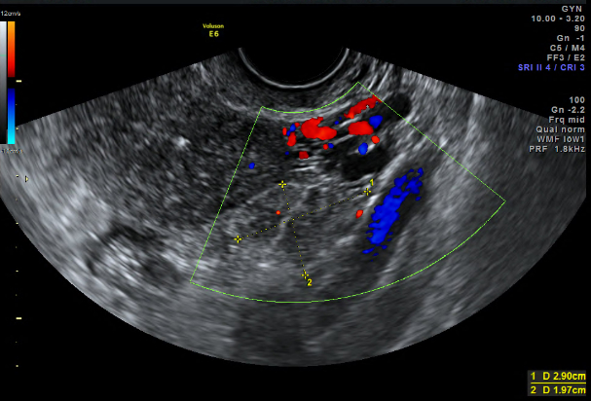
Patient Case (3) Vaginal Ultrasound
Left ovary is composed of 2 solid areas fixed between the uterus and sigmoid. Color score 2.
Right ovary, uterus, and upper abdomen are normal

Slide 5
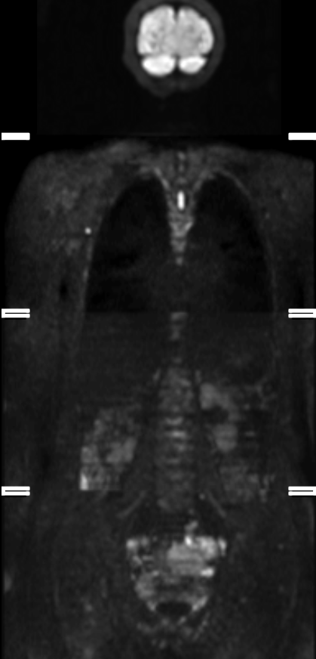
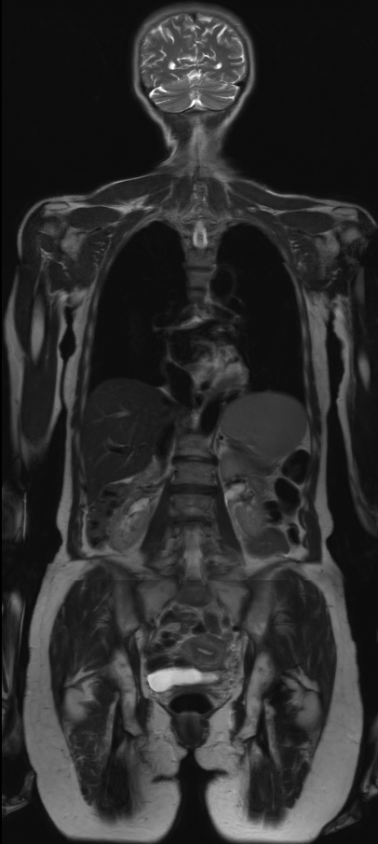
Patient Case (4) Diffusion-Weighted Whole-Body MRI
Left panel: diffusion MR showing pathologic uptake in left ovary (arrow) and infiltration sigmoid (dash arrows)
Right panel: anatomical correlative MR

Slide 6
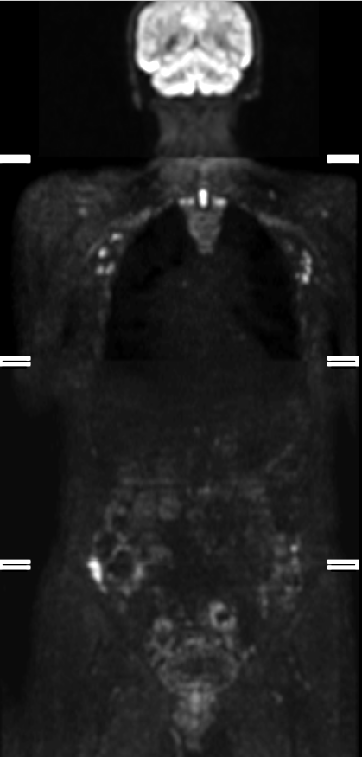
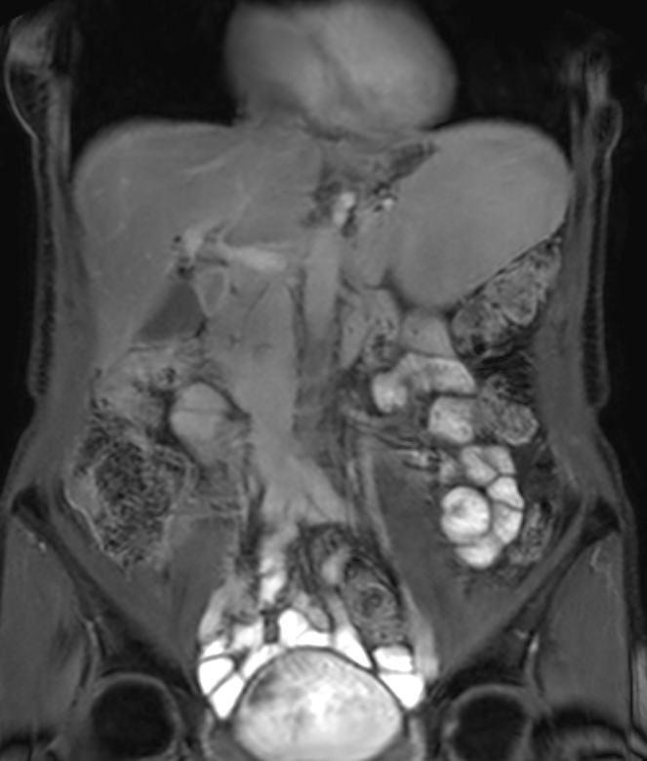
Patient Case (5) Diffusion-Weighted Whole-Body MRI
Left panel: diffusion MR showing tumor in both paracolic gutters (arrows) and infiltration sigmoid (dashed arrows)
Right panel: T2 Anatomical correlate at contrast MRI

Slide 7
Patient Case (6) Diffusion-Weighted Whole-Body MRI Further Findings:
Peritoneal carcinomatosis in the pouch of Douglas and on the pelvic peritoneum, including bladder peritoneum
Small (<1cm) metastases in the omentum
Small nodules on the right diaphragm
No pathological lymph nodes
No tumor in the thorax

Slide 8

Question 1: What is your preferred management?
Primary debulking
Neoadjuvant chemotherapy

Slide 9
Question 1: What is your preferred management?
Primary debulking
Neoadjuvant chemotherapy
72.5%
27.5%

Slide 10
Patient Case (7) Further Steps:
The patient underwent a primary debulking with extraperitoneal hysterectomy + BSO with en bloc resection of rectosigmoid and side-to-end anastomosis, pelvic and paraaortic lympadenectomy, omentectomy, peritoneal stripping, diaphragmatic resection
Macroscopic no residual tumor
High-grade serous ovarian carcinoma

Slide 11
Patient Case (8) Postoperative Management
The patient received 6 courses of 3-weekly paclitaxel-carboplatin + weekly trebananib/placebo followed by maintenance trebananib/placebo in the ENGOT-ov2/TRINOVA 3 study.

Slide 12
Patient Case (9) 4 Months After the End of Paclitaxel-Carboplatin
The patient has an increasing pain on the right side of the abdomen and the right upper leg, with signs of subobstruction.
CA125 increased from normal to 585 KU/L
CT thorax-abdomen shows progressive disease intraabdominally

Slide 13
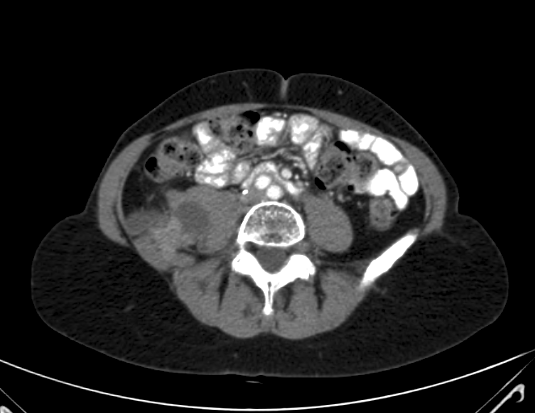
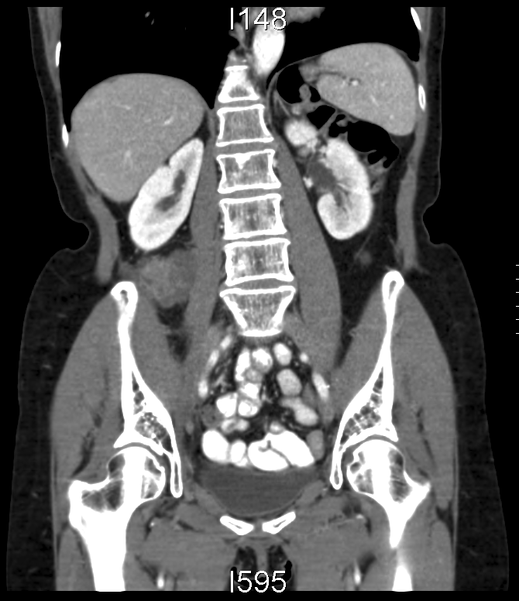
Lesion 1
Retroperitoneal mass caudal from right kidney, with impression and probable invasion of r. psoas muscle.
62.5 mm diameter
Notes:
Eadnr: 87502142

Slide 14
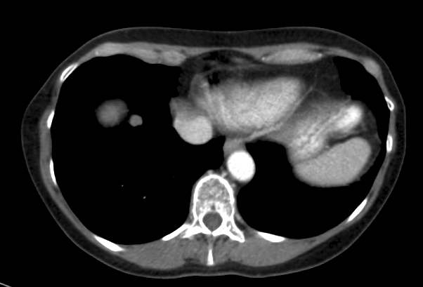
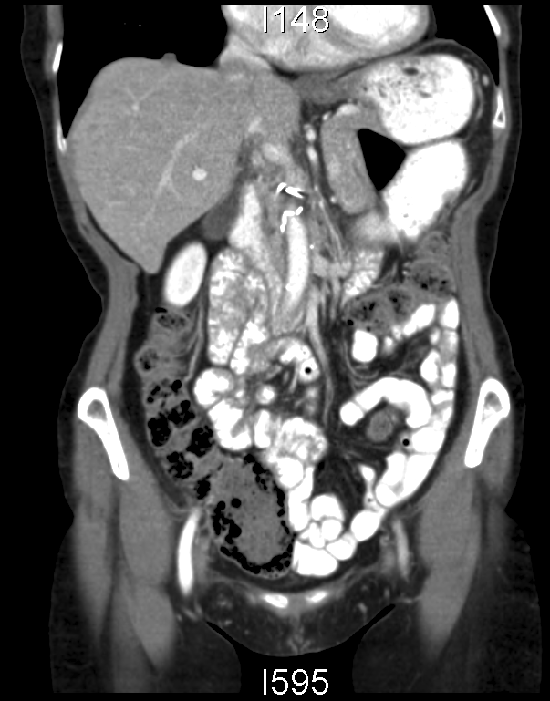
Lesion 2
Pleural implant, 10.9 mm diameter
Notes:
Eadnr: 87502142

Slide 15
Question 2: Platin-resistant ovarian cancer - What is your peferred treatment?
Supportive care
Carboplatin weekly
Paclitaxel w
Paclitaxel w + bevacizumab
Pegylated liposomal doxorubicin (PLD)
PLD + Bev
Topotecan
Topotecan + Bev
Studies
Other

Slide 16
Question 2: Platin-resistant ovarian cancer - What is your peferred treatment?
Supportive care
Carboplatin weekly
Paclitaxel w
Paclitaxel w + bevacizumab
Pegylated liposomal doxorubicin (PLD)
PLD + Bev
Topotecan
Topotecan + Bev
Studies
Other
0.9%
0%
2.7%
62.2%
13.5%
10.8%
5.4%
0%
4.5%
0%

Slide 17
Recurrent Ovarian Cancer: GCIG Definition
 | Treatment-Free Interval (from last dose of platin)
Platinum sensitive | >12 mo
Platinum-partially sensitive | 6-12 mo
Platinum-resistant | <6 mo
Platinum-refractory | <4 weeks
Friedlander M, et al. Int J Gynecol Cancer. 2011;21(4):771-775.

Slide 18
PFS and OS After Start of 1st-Line Chemotherapy
Results of the AGO-OVAR metadatabase (du Bois et al, Cancer 2009)
OS 3,126 pts. / 1,837 events
PFS 3,126 pts. / 2,375 events
5.0% progressing during chemotherapy
22.8% PFS 6-12 months
17.2% PFS 0-6 months
46,2% PFS
12-60 months
8.6 % PFS
60-120 months
Randomisation
Months
Du Bois A, et al. Cancer. 2009;115(6):1234-1244.

Slide 19
PFS and OS After Start of 1st-Line Chemotherapy
Results of the AGO-OVAR metadatabase (du Bois et al, Cancer 2009)
In the end almost all
relapsing patients
become platin-resistant
OS 3,126 pts. / 1,837 events
PFS 3,126 pts. / 2,375 events
5.0% progressing during chemotherapy
22.8% PFS 6-12 months
17.2% PFS 0-6 months
46,2% PFS
12-60 months
8.6 % PFS
60-120 months
Randomisation
Months
Du Bois A, et al. Cancer. 2009;115(6):1234-1244.

Slide 20
PFS and OS After Start of 1st-Line Chemotherapy
Results of the AGO-OVAR metadatabase (du Bois et al, Cancer 2009)
Influence of bev and other
antiangiogenic drugs
on % platin-resistant
after first line therapy!
In the end almost all
relapsing patients
become platin-resistant
OS 3,126 pts. / 1,837 events
PFS 3,126 pts. / 2,375 events
5.0% progressing during chemotherapy
22.8% PFS 6-12 months
17.2% PFS 0-6 months
46,2% PFS
12-60 months
8.6 % PFS
60-120 months
Randomisation
Months
Du Bois A, et al. Cancer. 2009;115(6):1234-1244.

Slide 21
Question 2: Platin-resistant ovarian cancer - What is your peferred treatment?
Supportive care
Carboplatin weekly
Paclitaxel w
Paclitaxel w + bevacizumab
Pegylated liposomal doxorubicin (PLD)
PLD + Bev
Topotecan
Topotecan + Bev
Studies
Other

Slide 22

Treatment of Patients With PFI <6 Months
Expected median OS <12 months
Main objective:
QoL (toxicity)
Control of symptoms

Slide 23
65 pts
232 pts
Canfosfamide 1g/m² iv d1 q21
Treosulfan 7 g/m² iv q21
R
R
Pegylated liposomal doxorubicin 50 mg/m² iv q28
or
Topotecan 1.5mg/m² iv d1-5 q21
Topotecan 1.5 mg/m² d1-5 q21
63 pts
229 pts.
AGO-OVAR 2.3
Meier W, et al. Proc Am Soc Clin Oncol. 2003;22: Abstract 1810.
Vergote I. Eur J Can. 2009;45(13):2324-2332.
100%
PFS
Topo
(63) median 4.2 months
75%
Treo
(65) median 2.2 months
HR = 1.44 [1.00
50%
-
2.07]
P = .0476
25%
0%
0
12
24
36
48
60
OR 19.3% (topo) vs 7.0% (P =.0524)

Slide 24
65 pts
232 pts
Worse
PFS and OS
Worse
Canfosfamide 1g/m² iv d1 q21
Treosulfan 7 g/m² iv q21
R
R
Pegylated liposomal doxorubicin 50 mg/m² iv q28
or
Topotecan 1.5mg/m² iv d1-5 q21
Topotecan 1.5 mg/m² d1-5 q21
63 pts
229 pts.
AGO-OVAR 2.3
Meier W, et al. Proc Am Soc Clin Oncol. 2003;22: Abstract 1810.
Vergote I. Eur J Can. 2009;45(13):2324-2332.
100%
PFS
Topo
(63) median 4.2 months
75%
Treo
(65) median 2.2 months
HR = 1.44 [1.00
50%
-
2.07]
P = .0476
25%
0%
0
12
24
36
48
60
OR 19.3% (topo) vs 7.0% (P =.0524)

Slide 25
Carboplatin Weekly Monotherapy…
N = 142 PROC
2nd line ≈ 4%
3rd line ≈ 40%
>3rd line ≈ 55%
Weekly CARBO AUC 2 + placebo
Weekly CARBO AUC2 + phenoxodiol
DRUG | ORR | PFS, weeks | OS, weeks
Weekly carbo AUC 2 + placebo | 1% | 15.4 | 38.3
Weekly carbo AUC2 + phenoxodiol | 0% | 20.1 | 45.7
Phenoxodiol: biomodulator shown to have chemoresistance-reversing potential
…is no longer active in PROC!!
PROC, platinum-resistant ovarian cancer
Fotopoulou C, et al. Ann Oncol. 2014;25(1):160-165.

Slide 26
Targeted Therapy in OC
Angiogenesis (no validated predictors)
PARP inhibitors
RAS-MEK pathway
Folate receptor
EGFR (erlotinib negative in first line)
ErbB3 (eg, pertuzumab...)
PI3K/AKT/mTOR
Selective nuclear export inhibitors (SINE)
p53, Aurora (eg, alisertib...)
Immuno eg, anti PD-1/PD-L1)
Targetting multiple pathways, ....
ADC
(high-grade serous – HRD)
(low-grade serous)
(all epithelial ov ca)
(PI3K: clear cell)

Slide 27
Ovarian Carcinoma: Randomized Phase II-III Trials With Targeted Therapy
Interval
Debulking
Secondary/tertiary
Debulking
Pazopanib: AGO OVAR16
Bev: AURELIA
CR or PR
Progression
> 6 months
Progression
< 6 months
(Late) Diagnosis
Death
Symptoms
Chemotherapy
Maintenance
Platin-
sensitive
Platin-
resistant
Maintenance
Bevacizumab: GOG218, ICON7
Nintedanib: AGO OVAR12
Bev: OCEANS
Cediranib: ICON6
Trebananib: ENGOT-ov2
Trebananib: Trinova-1
Olaparib: PARP19
Supportive Care
Primary Debulking
VEGF
ANG
PARP

Slide 28

ENGOT-ov3: Gineco Aurelia Bevacuzimab AGO, BGOG, DGOG, MITO, MaNGO, NSGO, GEICO
Patients with platinum-resistant ovarian cancer
n = 360, randomised 1:1
Arm 1 Chemotherapy choice of paclitaxel, topotecan, or PLD
Arm 2 Chemotherapy + bevacizumab*
If patient is experiencing toxicity related to either chemotherapy or bevacizumab, administer other drug alone until PD, unacceptable toxicity, or patient request for withdrawal
If PD, unacceptable toxicity, or patient request for withdrawal
Optional bevacizumab**
Standard of care
Survival follow-up
*10 mg/kg iv q2w (15 mg/kg q3w will be used instead if topotecan is selected and administered at a dose of 1.25 mg/m² on a 1–5/q3w schedule); ** 15 mg/kg i.v. q3w; PLD, Pegylated liposomal doxorubicin; PD, progressive disease

Slide 29
ENGOT-ov3: AURELIA BEV in Relation to Treatment Cohort
1.00
0.75
0.50
0.25
0
Paclitaxel cohort
HR = 0.46
(95% CI 0.30–0.71)
1.00
0.75
0.50
0.25
0
Topotecan cohort
HR = 0.32
(95% CI 0.21–0.49)
Estimated Probability
10.4
Estimated Probability
5.8
3.9
2.1
0 3 6 9 12 15 18 21 24
0 3 6 9 12 15
PFS (months)
PFS (months)
22.9ª
[3.9–41.8]
1.00
0.75
0.50
0.25
0
PLD cohort
HR = 0.57
(95% CI 0.39–0.83)
10.4ª
[–2.4 to 23.2]
19.5ª
[6.7–32.3]
5.4
ORR (RECIST, CA-125 criteria or both) (%)
Estimated Probability
3.5
0 3 6 9 12 15 18
PFS (months)
HR = hazard ratio
ªDifference in ORR; 95% CI with Hauck–Anderson continuity correction

Slide 30
Primary and sensitivity analyses of the primary hypothesis (15% improvement abdominal/GI symptoms)
AURELIA Patient-Reported Outcome Analysis
Patients, %
12.7%
[4.4, 20.9]
P = .002
14.2%
[4.9, 23.6]
13.3%
[4.5, 22.1]
12.0%
[4.5, 19.5]
Stockler MR, et al. J Clin Oncol. 2014;32(13):1309-1316.

Slide 31
TRINOVA-1: Trebananib
Recurrent EOC
≤3 prior anticancer regimens
Evaluable or measurable disease
GOG performance status of 0 or 1
PFI <12 months
Weekly Paclitaxel +
Placebo
Treat to PD/toxicity
R
Weekly Paclitaxel + Trebananib
Treat to PD/toxicity
1:1
Paclitaxel 80 mg/m² IV on days 1, 8, 15 Q4W
Trebananib 15 mg/kg IV QW
ClinicalTrials.gov Identifier: NCT01204749
Stratification Factors
Platinum-free interval (PFI) (≤6 vs >6 months)
Measurable disease (Yes/No)
Region (North America, Western Europe/Australia, Rest of World)
EOC, epithelial ovarian cancer including primary peritoneal, or fallopian tube cancer; PD, progressive disease

Slide 32
TRINOVA-1: Progression-Free Survival Platinum-Free Interval (PFI)
PFI ≤ 6 months | Pac + Placebo (n = 458) | Pac + Trebananib (n = 461)
Events/Patients (%) | 203/245 (83) | 178/235 (76)
Median PFS, mo | 3.8 | 5.6
 | HR = 0.65 (95% CI, 0.53–0.79)
PFI > 6 months | Pac + Placebo (n = 458) | Pac + Trebananib (n = 461)
Events/Patients (%) | 157/212 (74) | 129/223 (58)
Median PFS, mo | 5.6 | 7.6
 | HR = 0.66 (95% CI, 0.52–0.84)

Slide 33
TRINOVA-1: Progression-Free Survival Prior Antiangiogenic Therapy
 | Pac + Placebo (n = 458) | Pac + Trebananib (n = 461)
Events, n (%) | 34/37 (92) | 25/35 (71)
Median PFS, months | 3.7 | 5.4
 | HR = 0.69 (95% CI, 0.41–1.17)

Slide 34
Antiangiogenesis in Ovarian Cancer
What we know:
Antiangiogenetic drugs, targeting VEGF or angiopoetin, are active in prolonging PFS and OS in some subgroups of ovarian cancer.
What we do not know:
When should an angiogenesis inhibitor be given (first-line, platin-sensitive, platin-resistant)? Or in all lines? How long?
Which angiogenesis inhibitor should be prefered in which group of ovarian cancer patients? And which are active after progression on another angiogenesis inhibitor?
Validated biomarkers for efficacy of antiangiogenesis are still needed.
What is the potential for combination of VEGF inhibitors with other classes of antiangiogenetic drugs (eg, ang inhibitors) or other targeted therapies such as PARP, MET,… inhibitors?

Slide 35
Question 2: Platin-resistant ovarian cancer - What is your peferred treatment?
Supportive care
Carboplatin weekly
Paclitaxel w
Paclitaxel w + bevacizumab
Pegylated liposomal doxorubicin (PLD)
PLD + Bev
Topotecan
Topotecan + Bev
Studies
Other

Slide 36
Progression-Free Survival – Lurbinectedin
Platinum Resistant
1.0
1.0
PM01183
PM01183
(N = 17 C = 4)
(N
Topotecan
0.9
Topotecan
(N = 16 C = 2)
0.9
Censored
Censored
0.8
0.8
Probability
0.7
0.7
HR: 0.30
(95%CI 0.12
-
0.6
5.7 mo.
-
0.72)
0.6
P = .005*
0.5
0.5
0.4
1.7 mo.
0.4
Cumulative
Cumulative
0.3
0.3
0.2
0.2
0.1
0.1
0.0
0.0
0
0
1
1
2
2
3
3
4
4
5
5
6
6
7
7
8
8
9
9
10
10
11
11
12
12
13
13
14
14
15
15
16
16
Time, Months
*
*
log
log
-
-
rank
rank
test
test
Poveda A, et al. J Clin Oncol. 2014;32(5S): Abstract 5505.

Slide 37
Pertuzumab: ENGOT-ov14/Penelope
Stratification factors
Selected chemotherapy cohort (topotecan vs paclitaxel vs gemcitabine)^{b}
Previous antiangiogenic therapy (yes vs no)^{c}
Treatment-free interval from last cycle of platinum to PD after platinum therapy (<3 vs 3–6 months)
Stratification factors
Selected chemotherapy cohort (topotecan vs paclitaxel vs gemcitabine)^{b}
Previous anti-angiogenic therapy (yes vs no)^{c}
Treatment-free interval from last cycle of platinum to PD after platinum therapy (<3 vs 3–6 months)
Arm 1 (n ≈ 77)
Pertuzumab
Patients with epithelial ovarian primary peritoneal or fallopian tube cancer, with low HER3 mRNA expression (n~154)
RANDOM
I SAT I ON
+
Choice of chemotherapy at investigator’s discretionª
Topotecan, paclitaxel or gemcitabine
Until disease progression, unacceptable toxicity, withdrawal of consent, or death
Arm 2 (n ≈ 77)
Placebo
+
Topotecan, paclitaxel or gemcitabine
1:1
Until disease progression, unacceptable toxicity, withdrawal of consent, or death
ªTopotecan, paclitaxel, or gemcitabine. ^{b}To be amended if not all chemotherapy agents are used in Part 2. ^{c}If a patient has previously participated in a blinded trial with an antiangiogenic agent, the patient will be enrolled in the same stratum as patients known to have previously received an antiangiogenic agent.

Slide 38
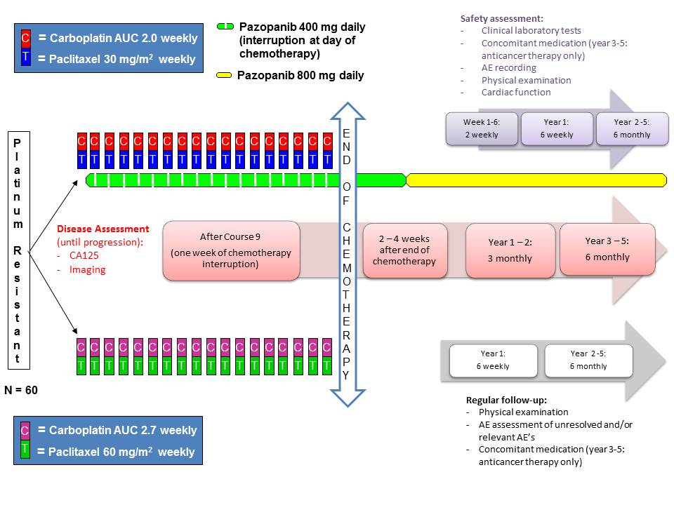
Randomized Phase II EORTC 55092 TC weekly with or without pazopanib in PROC
Measurable or evalauble

Slide 39


Single Target, Simultaneous Inhibition of Multiple Oncogenic Pathways : Hsp90 Clients
Deactivate driver oncogenes
ALK, EGFR, HER2, KRAS pathway (RAF, MEK, ERK), AR, ER, JAK2
Reduce tumor spread
Angiogenesis: HIF-1α, VEGFR, PDFGR, VEGF
Metastasis: MET, RAF, AKT, MMPs, HIF-1α, IGF-1R
HSP90
Enhance chemotherapy + targeted agents
DNA repair, antiapoptosis, cell cycle checkpoint: ATR, BRCA1/2, BCL2, CDK1/4, CHK1, survivin, WEE1, HIF-1α
p53mut

Slide 40

Randomised, Two-Arm Phase II Study
Ganetespib iv 150 mg/m² d1,8,15 Q4wks
+
Paclitaxel iv 80 mg/m² d1,8,15; Q4 wks)
Screening
R
A
N
D
O
M
I
Z
A
T
I
O
N
*
Patients with platinum-resistant high-grade serous, high-grade endometrioid, or undifferentiated ovarian cancer
R
E
G
I
S
T
R
A
T
I
O
N
Central histopathologic review
1:2
2:1
Paclitaxel iv 80 mg/m² d1,8,15; Q4 wks
*
N = 222
Exclusion of patients with noneligible tumors: Treatment at physician’s choice
*Till progression. If paclitaxel no longer tolerated or after 6x Pw, maintenance G can be given.

Slide 41
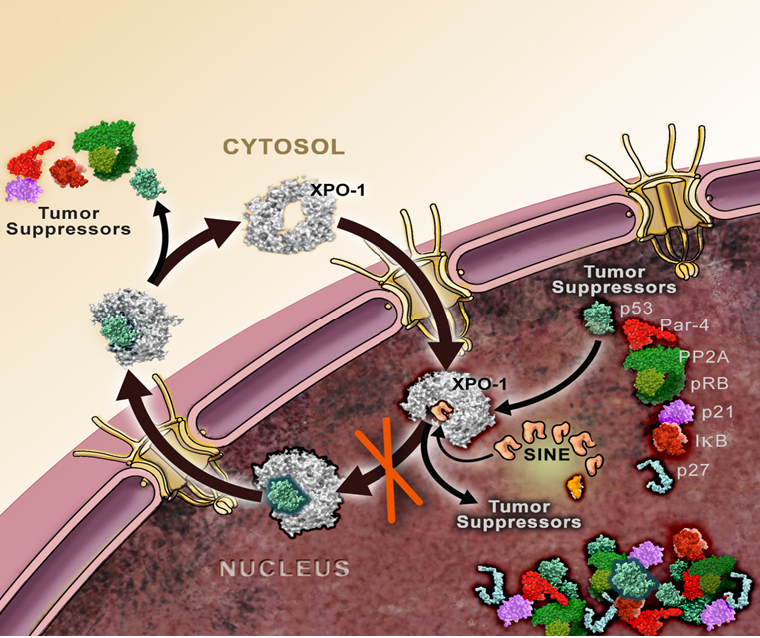
Selective Inhibition of Nuclear Export (SINE): Agents Activating Multiple Tumor-Suppressor Proteins
Cancer cells can inactivate their tumor-suppressor proteins (TSPs) via the nuclear export mechanism
CRM1 (Exportin 1) is the nuclear exporter of most TSPs
Blockade of CRM1 leads to nuclear retention and activation of multiple TSPs
KPT-330 is an irreversible, oral selective inhibitor of nuclear export against CRM1
Razak A, et al. J Clin Oncol. 2013;31(Suppl): Abstract 2505.

Slide 42
Randomized Phase II of DNIB0600A vs PLD in PROC
Overview of Trial Design
Enrollment:
~92 “all-comer” patients
~30 sites
Key eligibility:
PROC with ≤1 cytotoxic therapy in the PROC setting
Archival tissue confirmed at site
PLD q4w
Follow-Up OS
Randomize 1:1
NaPi2b ADC q3w
Follow-Up OS
ADC, antibody-drug conjugate

Slide 43
Future Research on Targeted Therapy in Ovarian Cancer
Ovarian carcinoma comprises different tumor types and should be treated differently according to the molecular profile.
New trials are currently including only patients with
A specific tumor type or
With a specific mutation or amplification or
An ADC with a target that is present in almost all ovarian cancer cells (alpha folate receptor, NaPi2b, …) or
Drugs attacking one target involved in many pathways.

Slide 44
Patient Case (10) 4 Months After the End of Paclitaxel-Carboplatin
The patient has an increasing abdominal pain with signs of subobstruction.
CA125 increased from normal to 585 KU/L
CT thorax-abdomen shows progressive disease intraabdominally.

Slide 45
Patient Case (10) 4 Months After the End of Paclitaxel-Carboplatin
The patient received weekly paclitaxel and bevacizumab.

